Slide 1

PG Rules & Regulations
Department of Computer Science and Engineering (CSE)‏
Bangladesh University of Engineering and Technology (BUET)
Notes:
1

Slide 2






Dept. offer courses
Std. register courses
Adv/Sv forwards reg.
Std. add/drops courses
Adv. forwards Add/drop
HoD Approves reg.
HoD approves Add/Drop
Late Reg. window
Advisor or Supervisor?
2 Sem./Academic Year
April
October
14 Weeks Class
2 Weeks Final Exam

Slide 3
Some Crucial Information
Masters
M.Sc. Engg.
M. Engg.
Ph.D.
36 Cr.Hr.
54 Cr.Hr.
18 Cr. Courses
18 Cr. Thesis
30 Cr. Courses
6 Cr. Project
Full-time
Part-time
12~15 Cr.
9 Cr. Max
4 sem.++ (M)
3 sem.++ (M)
4 sem.++ (P)
6 sem.++ (P)
9 Cr. Courses
45 Cr. Thesis
>=50% theory courses
Max Length
PhD: 6 yrs
Masters: 5 yrs
Further through CASR

Slide 4
Thesis Registration
Supervisor assignment is mandatory for thesis registration
Discuss with prospective supervisors
Form available in CSE office
After assignment, supervisor will approve registration

Slide 5


M.Sc.Engg. Workflow
CGPA >=2.65
BPGS
12 Cr. Course
Supervisor
Complete Course Credits
Complete Thesis Credits
Proposal Presentation
Proposal Passed by CASR
Pre-defence
Defence
BoE
(Sv, Co-Sv, HoD, 1~2 Int, 1 Ext)
Result Publication
Interleaved
BoE - Ext
Full Thesis must be submitted to the BoE before…
BPGS => CASR
BoE

Slide 6
M.Engg. Workflow
CGPA >=2.65
BPGS
12 Cr. Course
Supervisor
Complete Course Credits
Complete Thesis Credits
Proposal Presentation
Proposal Passed
Defence
BoE
(Sv, 2 Int or (1 Int + 1 Ext))
Result Publication
Interleaved
BoE
Only slightly different for M.Eng..
BPGS => VC

Slide 7

PhD Workflow
Complete Course Credits (CCC)
Complete Thesis Credits
Progress Presentations (Recurring)
Proposal Passed by CASR
Defence
BoE
(Doc. Comm. + >= 1 Ext.)
Result Publication
Comprehensive Exam
Proposal Presentation
Supervisor (1 Sem) & DC (3 Sem)
DC
CGPA >=2.75
BPGS => CASR
Provisional
5~7 members
Sv, CSv, HoD,…
BPGS => CASR
DC
CCC
DC
Thesis submitted
BoE
Admission
Confirmation

Slide 8
Supervisor and Committees
Doctoral Committee
Board of Examiners
Within 3 semesters
After proposal approval
Doctoral Committee
5-7 members including Sv, CSv, HoD
Supervisor
Within 1 semester
Co-supervisor if necessary
Approved by CASR
Supervisor (chairperson)
HoD (ex-officio)
Approved by CASR
One or more external members
At least one from outside the university
Approved by CASR

Slide 9
Presentation Requirements
Masters
Ph.D.
1 presentation
2 presentations
>=3 attendances
>=2 attendances
Departmental Seminars
Saturday afternoons

Slide 10
Evaluation Mechanism
In- Course
Tests
Assignments
Mid-Terms
Projects
Sem. Finals
written examination and / or other tests
Combined
Evaluation
In-Course
Sem. Finals

Slide 11



Grading System
Grade | Merit description
A+ | Excellent
A | Very good
B+ | Good
B | Average
C | Pass
F | Failure
I | Incomplete
S | Satisfactory
U | Unsatisfactory
W | Withdrawn
0.0 2.0 2.5 3.0 3.5 4.0
F C B B+ A A+
… 50 60 70 80 90 100

Slide 12
Grade Related Regulations
C grades
<=2 courses, may be ignored
Improve CGPA
Repeat Courses
Better grades prevail
Grade I
Apply within one week after exam
Complete within next 2 sem. (or I => F)
S or U
For Thesis and Audit courses.
Grade W
withdraw officially from a course
within two working weeks
2 courses and F courses may be repeated
Transcript
All grades in the transcript
Including F
Not W

Slide 13

Semester Withdrawal
Apply
Within 1 week of Exam
Documents
Medical Certificates from CMO
Documents
Official Commitment
Apply to HoD
BPGS
AC

Slide 14
Admission Cancelled
Masters
PhD
>= 3 F grades
Fail in Comprehensive Twice
Fail to Finish within stipulated period
Not progressing Satisfactorily (Sv->BPGS->CASR)
Disciplinary Actions
Self Withdrawal
CGPA < 2.5 (from Sem. 2+)
Fail in the Oral Defence Twice
Non-payment of Dues
Academic
Non-Academic

Slide 15

An Exceptional Pathway…
completion of course work
CGPA >= 3.0
Excellent Progress in thesis
M.Sc. Engg.
BPGS => CASR
PhD
(Provisional)
Failure to complete PhD =>
May still get the M.Sc. Engg. degree

Slide 16
(New) Programs
CSE
M.Sc. Engg.
M. Engg.
Cyber Security
AI & ML
Ph.D.
SWE
M.Sc. Engg.
M. Engg.
Ph.D.
Ph.D.
M.
M.Sc.
Computing
M.
Ph.D.
Data Science
M.Sc.
M.
Ph.D.
M.Sc.
M.
Ph.D.
M.Sc.
April 2024

Slide 17
New Program Structures
Core Courses
4 out of 6
12 Cr. Hr.
Other Courses
2 Out of 6
6 Cr. Hr.
Thesis
18 Cr. Hr.
Foundation
2/3 Audit Courses
AI&ML: N/A
DS: 3
Others: 2; Only for Group B
M.Sc
M.Sc
Cyb. Sec.
M.Sc
AI&ML
M.Sc.
DS
Comp.
Core Courses
2 out of 3
6 Cr. Hr.
Other Courses
1 Out of 3
3 Cr. Hr.
Thesis
45 Cr. Hr.
Foundation
2/3 Audit Courses
AI&ML: N/A
DS: 3
Others: 2; Only for Group B
Ph.D.
Ph.D.
Cyb. Sec.
Comp.
Ph.D.
AI&ML
Ph.D.
DS

Slide 18
New Program Structures
Core Courses
4 out of 6
12 Cr. Hr.
Other Courses
2 Out of 6
6 Cr. Hr.
Thesis
18 Cr. Hr.
Foundation
2/3 Audit Courses
AI&ML: N/A
DS: 3
Others: 2; Only for Group B
M.Sc
M.Sc
Cyb. Sec.
M.Sc
AI&ML
M.Sc.
DS
Comp.
[Group A] 4-year B.Sc. in Computer Science and Engineering (CSE) or Electrical and Electronic Engineering (EEE) or Computer Science (CS) or Computer Engineering (CE) or Electrical and Computer Engineering (ECE) or equivalent field.
[Group B] 4-year Bachelor’s degree in any other engineering or mathematical science or natural science or business information systems or related field.

Slide 19
New Program Structures
[Group A] Master’s degree in Cyber Security or Computer Science and Engineering (CSE) or Electrical and Electronic Engineering (EEE) or Computer Science (CS) or Computer Engineering (CE) or Electrical and Computer Engineering (ECE) or equivalent field.
[Group B] Master’s degree in any other engineering or mathematical science or natural science or business information systems or related field.
Core Courses
2 out of 3
6 Cr. Hr.
Other Courses
1 Out of 3
3 Cr. Hr.
Thesis
45 Cr. Hr.
Foundation
2/3 Audit Courses
AI&ML: N/A
DS: 3
Others: 2; Only for Group B
Ph.D.
Ph.D.
Cyb. Sec.
Comp.
Ph.D.
AI&ML
Ph.D.
DS

Slide 20
New Program Structures
Core Courses
4 out of 6
12 Cr. Hr.
Other Courses
2 Out of 6
6 Cr. Hr.
Thesis
18 Cr. Hr.
Foundation
2/3 Audit Courses
AI&ML: N/A
DS: 3
Others: 2; Only for Group B
M.Sc
M.Sc
Cyb. Sec.
M.Sc
AI&ML
M.Sc.
DS
Comp.
[Group A] 4-year B.Sc. in Computer Science and Engineering (CSE) or Electrical and Electronic Engineering (EEE) or Computer Science (CS) or Computer Engineering (CE) or Electrical and Computer Engineering (ECE) or equivalent field
[Group B] 4-year Bachelor’s degree in any other engineering or mathematical science or natural science or related field.

Slide 21
New Program Structures
[Group A] Master’s degree in Computer Science and Engineering (CSE) or Electrical and Electronic Engineering (EEE) or Computer Science (CS) or Computing or Computer Engineering (CE) or Electrical and Computer Engineering (ECE) or equivalent field
[Group B] Master’s degree in any engineering field other than mentioned in Group A above.
Core Courses
2 out of 3
6 Cr. Hr.
Other Courses
1 Out of 3
3 Cr. Hr.
Thesis
45 Cr. Hr.
Foundation
2/3 Audit Courses
AI&ML: N/A
DS: 3
Others: 2; Only for Group B
Ph.D.
Ph.D.
Cyb. Sec.
Comp.
Ph.D.
AI&ML
Ph.D.
DS

Slide 22
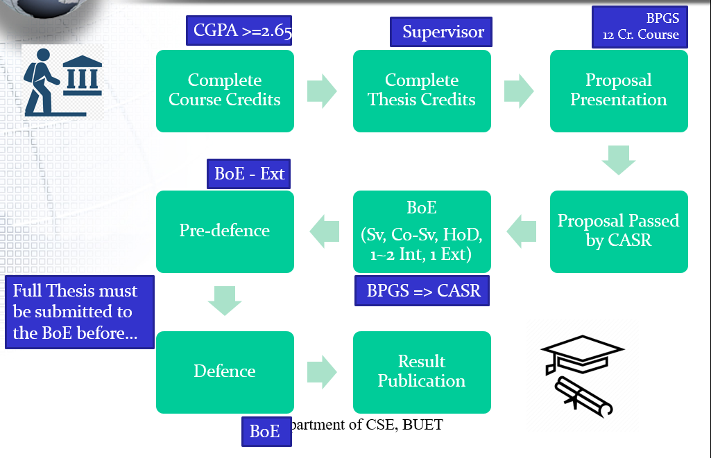
Extra Workflow for (some) M.Sc. programs
Audit Courses
Credit Courses
For Group B
BPGS can waive
Current Decisions (Admission Grouping)
Cyber.
Comp.
Through Appl.
Group 1: Auto-Waived
Group 2 : No Waiver
For M.Sc. (DS)
All

Slide 23
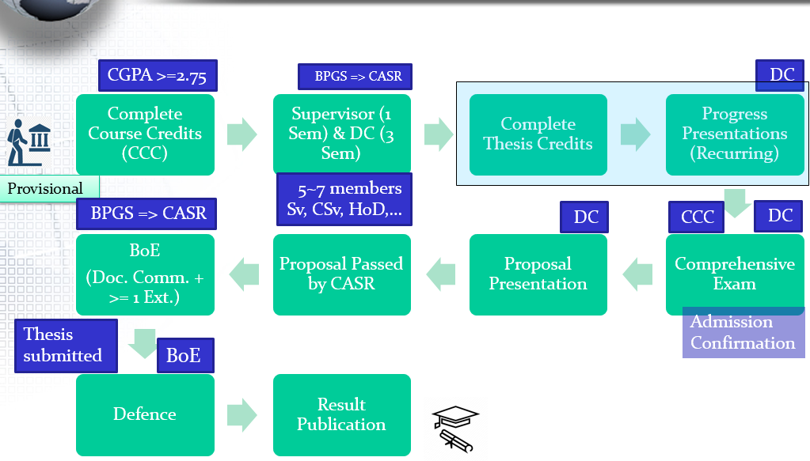
Extra Workflow for (some) Ph.D Divisions
Audit Courses
Credit Courses
For Group B
BPGS can waive
Cyber.
Comp.
Through Appl.
For M.Sc. (DS)
All

Slide 24
PG Fellowship
18 Months for M.Sc. Engg.
36 Months for Ph.D.
Only for FT students
GPA >= 3.00
Each Semester
Satisfactory Thesis Progress
40 Hours per Week @ BUET
Cannot have both TA and Fellowship
Must complete the Degree or return Money
30K/mon (M)
45K/mon (P)

Slide 25
TA-ship
Max 3 Sem. for M.Sc. Engg.
Max 6 Sem. for Ph.D.
Only for FT students
20 Hours per Week @ BUET
(HoD assigned)
Basic Salary of a Lecturer (22K)
CGPA >= 3.0 in the previous Sem.
Awarded on a 6 month basis
No other BUET Financial Aid allowed
25% will be withheld till completion
Must complete the Degree or return Money

Slide 26
Important Dates
Registration: April 25 – May 2, 2026
Add-drop/late registration: May 3 – May 15, 2026
Fellowship/TA applications: May 13 – May 21, 2025

Slide 27

BUET PhD Ordinance

Slide 28


